Slide 1
Multi-Days Stock Prediction Model
Prepared by: Meng Chin DSI20

Slide 2
Problem Statement
Stock Classification
Conclusion
& Recommendation
1
3
5
2
4
6
Data Collection and EDA
Modeling
Q&A

Slide 4
Problem Statement
To Create a Model that will help us to predict a series of future prices

Slide 5
Data Collection

Slide 6
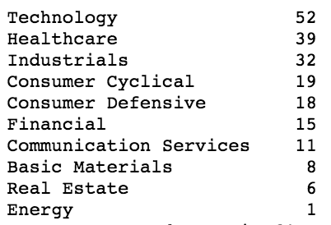
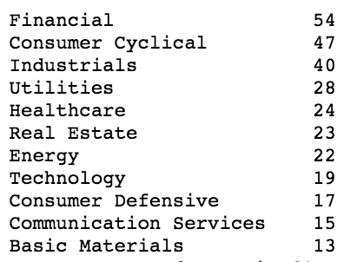
KMeans Unsupervised Learning
Cluster 1
Cluster 2

Slide 7
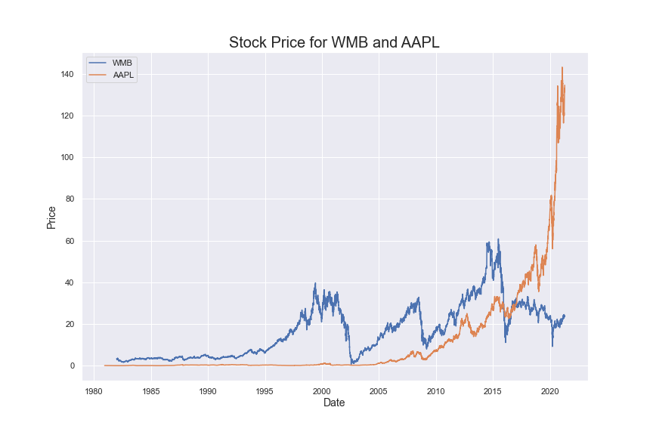

Slide 8
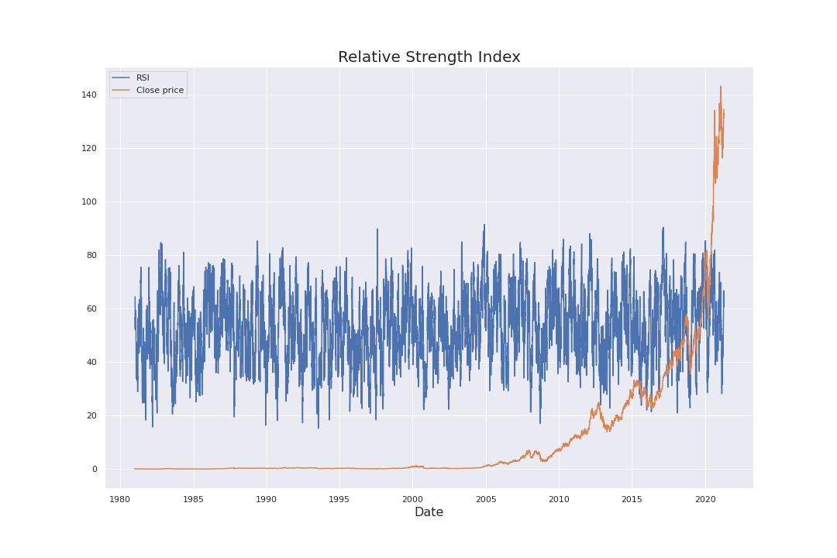
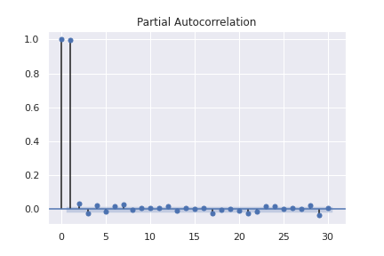
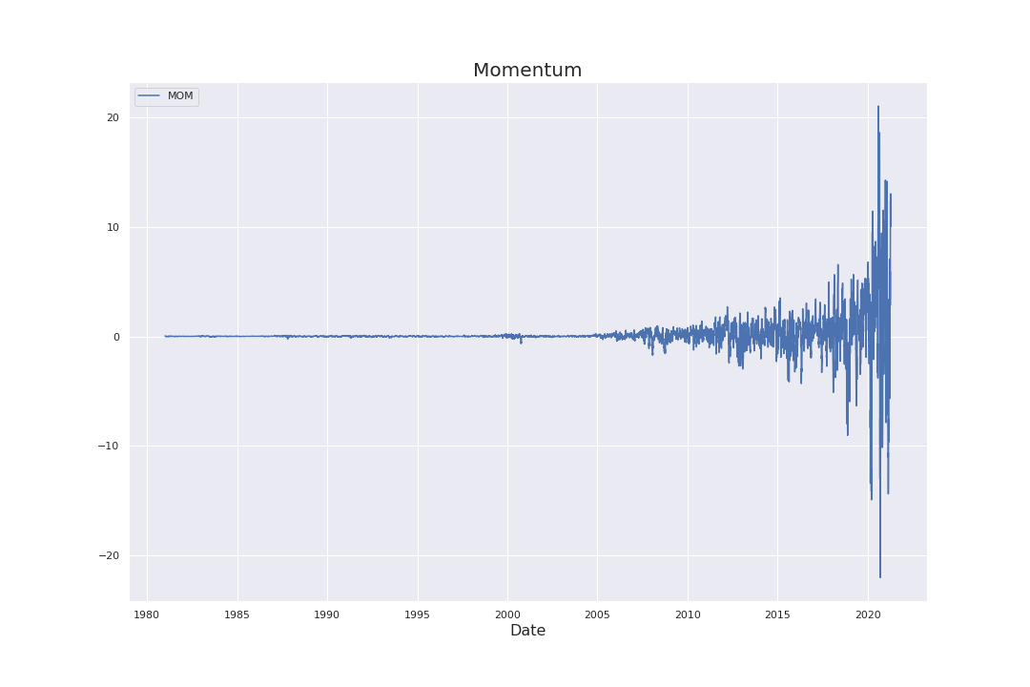
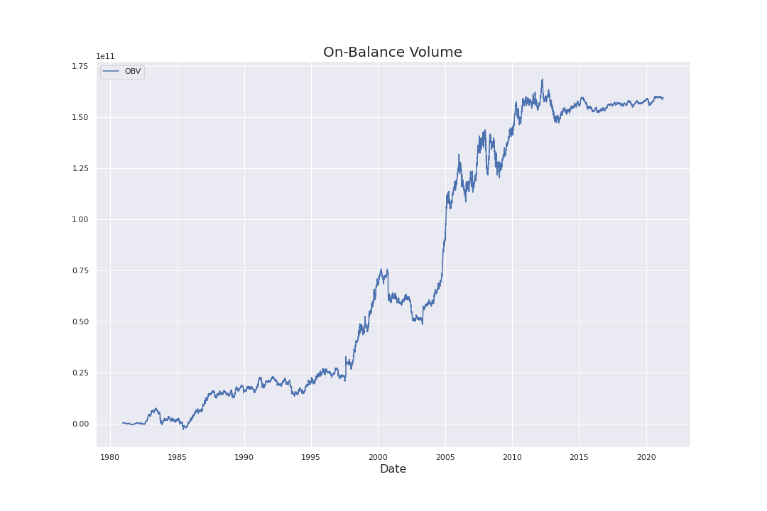

Slide 9

MODEL
STACK LSTM
ENCODER DECODER
ATTENTION

Slide 10
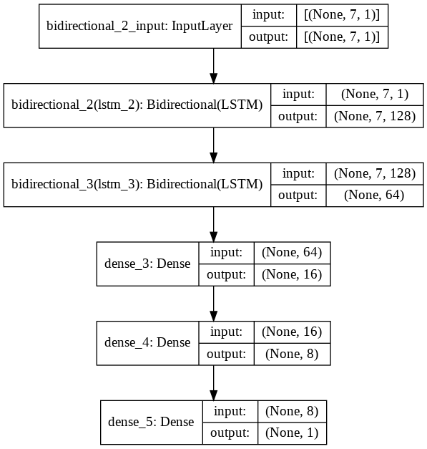
STACK LSTM

Slide 11
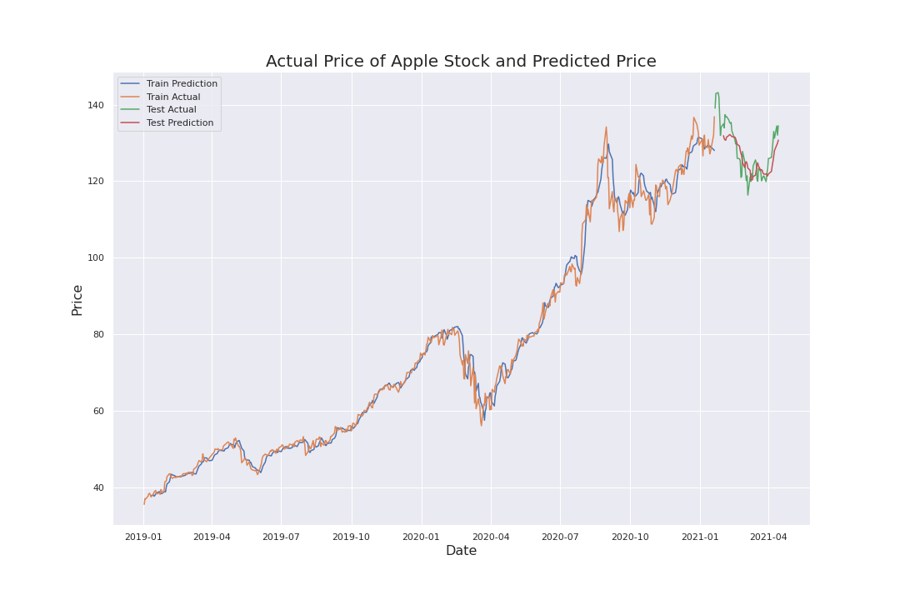
Stack LSTM

Slide 12
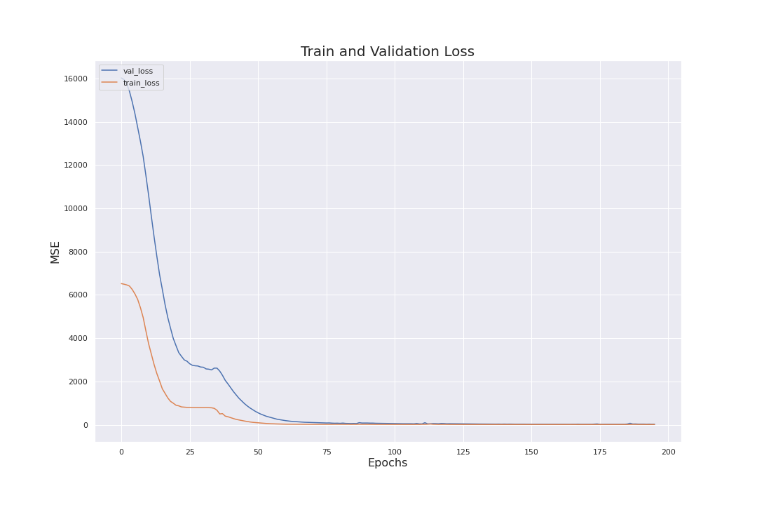
Stack LSTM

Slide 13
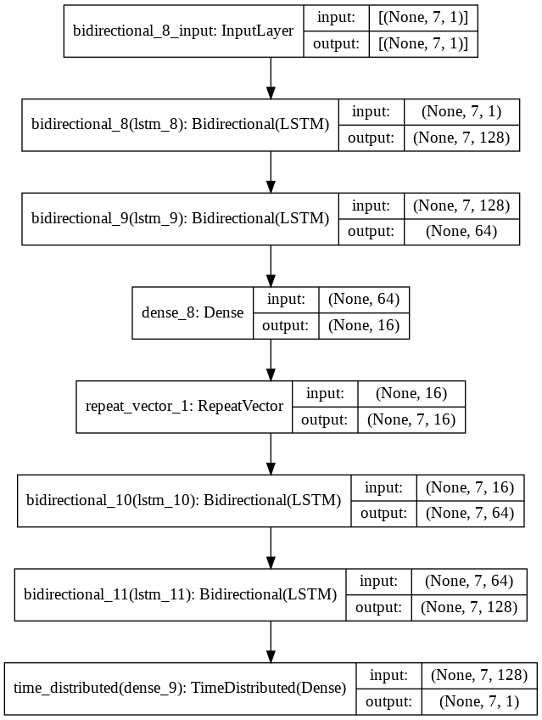
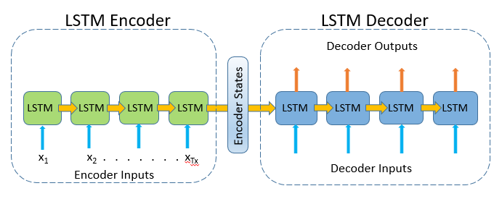
ENCODER DECODER

Slide 14
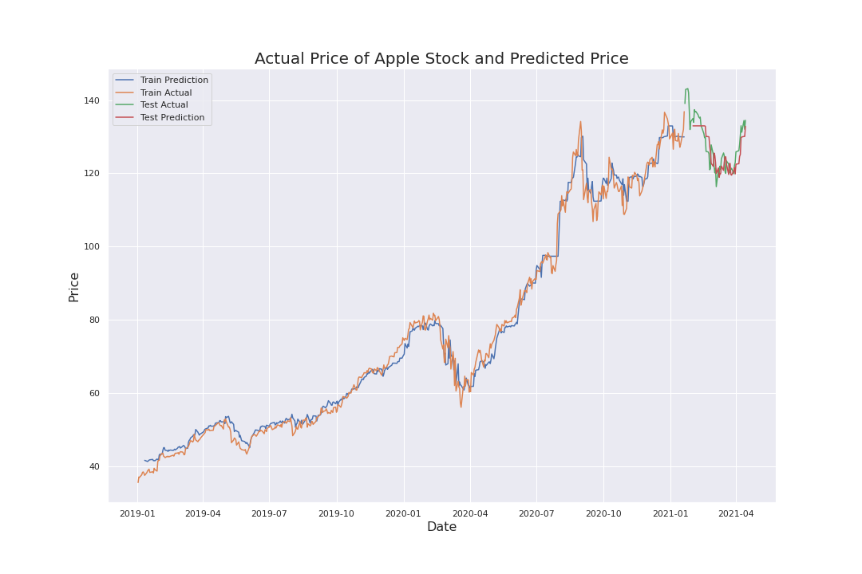
Encoder Decoder

Slide 15
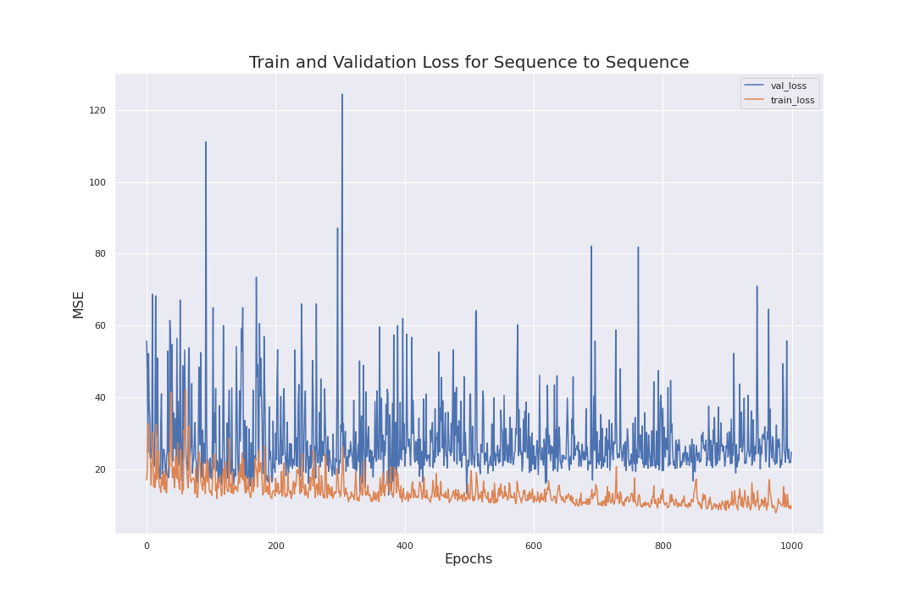
Encoder Decoder

Slide 16
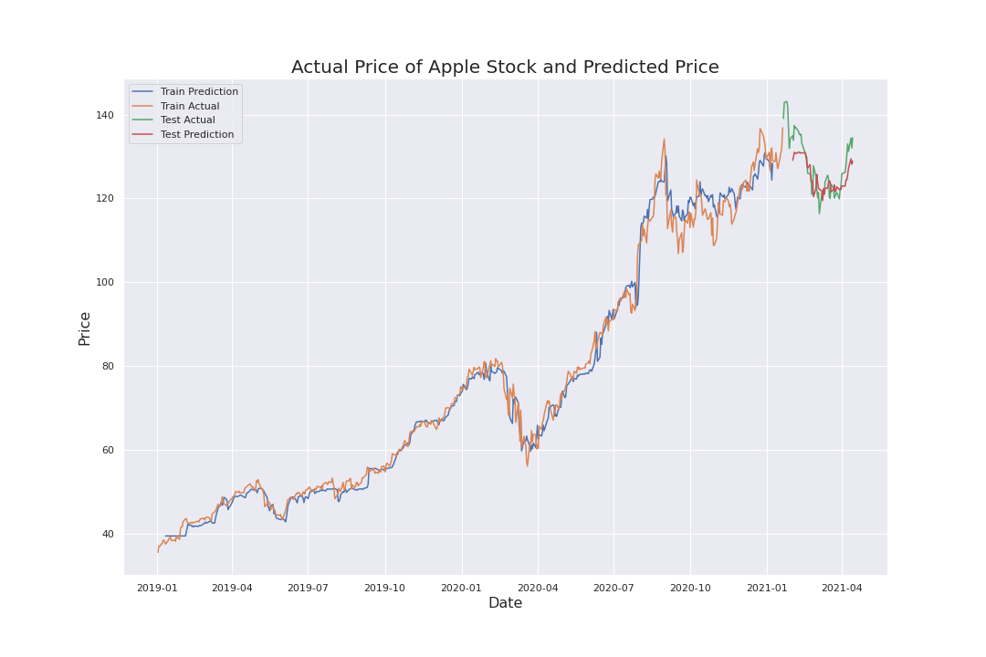
Encoder Decoder

Slide 17
Encoder Decoder

Slide 18
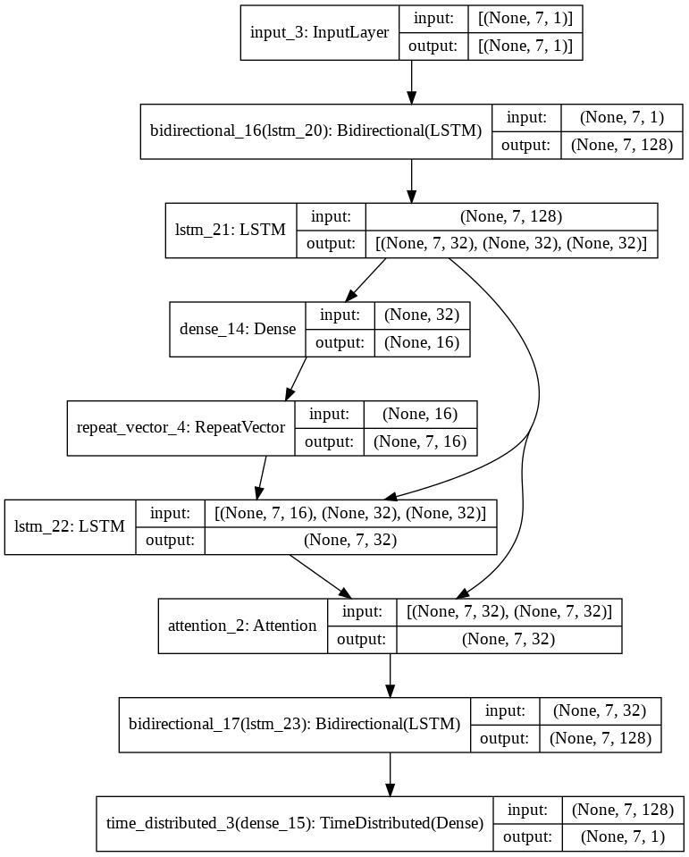
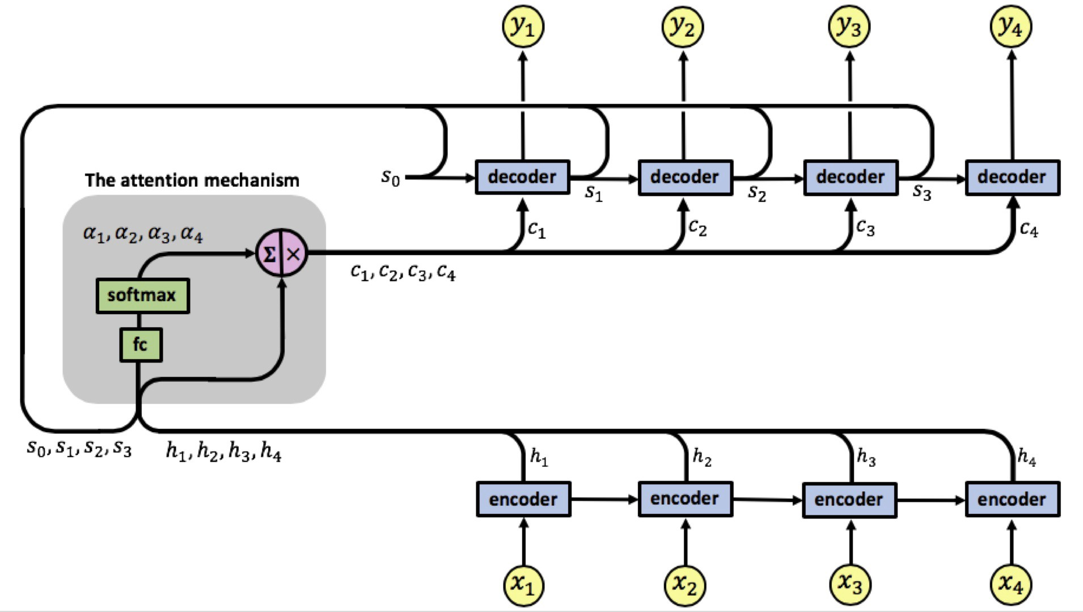
Attention

Slide 19
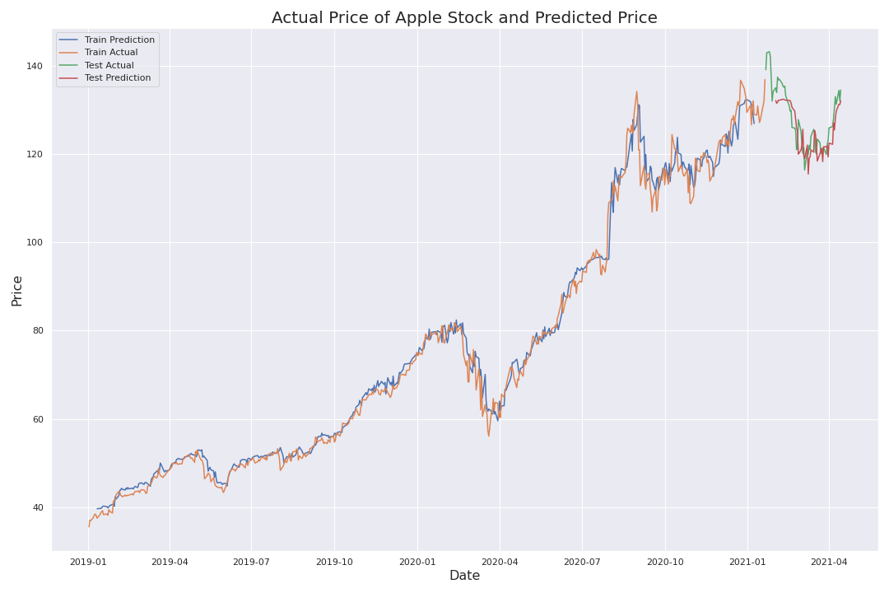
Attention

Slide 20
Attention

Slide 21
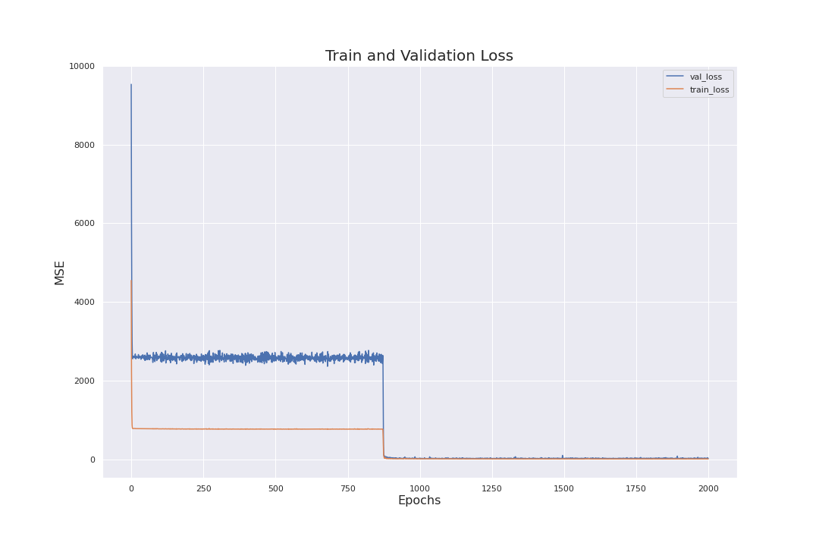
Attention

Slide 22
CONCLUSION
Learning Rate Tuning is very important
Need to run longer epochs
Be careful of Early Stopping

Slide 23
Future Recommendation
To include buy/sell signal as output
To consider using Time2Vec instead of LSTM
Try more input features

Slide 24

THANK YOU

Slide 25
Credits
Special thanks to all the people who made and released these awesome resources for free:
Presentation template by SlidesCarnival
Photographs by Unsplash

